Slide 1
Calderdale Big Conversation

Slide 2
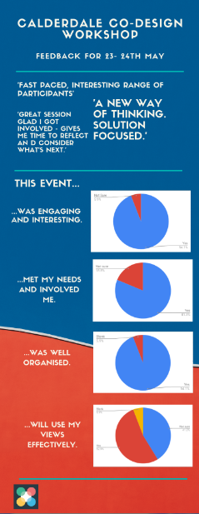
Today…10-3pm
Who are we?
Recap
Prototype testing
LUNCH
Plan for ideas into real world
‘Doing it’ - Calendar
Support & Learning needs
Next steps

Slide 3
Democracy in your living room
How do we make conversations that are interesting and about Calderdale that people might take home with them?
How do we take conversations to people - and give them the chance to talk about it for themselves?

Slide 4
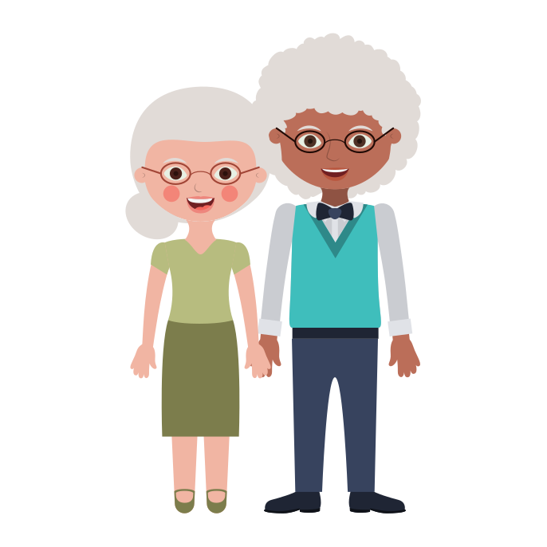
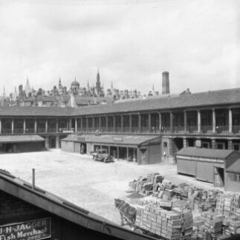
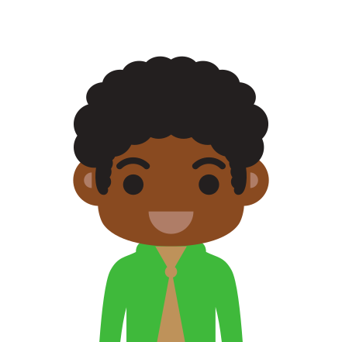
Calderdale knows it's changed but what does that mean for people who live here?
Place
Calderdale has changed as a place - part of this story is about the council but it's also about people
How has Calderdale, the physical place itself, changed?
People
We're different as people - generational divides are greater
We don't have the same patterns or live with the same pressures
Our hopes and aspirations have changed
Wider World
We're part of a connected world in a way we weren't before
Its influence on how we live is greater, but in what ways?
How does a changing world affect Calderdale?

Slide 5
Since last time…
4 big ideas on project posters
Thinking shared with others… council staff, politicians, Health
More concrete descriptions of what it all means!

Slide 6
Calderdale Big
Conversation
What is it?

Slide 7
Calderdale Big Conversation
Think about things that matter to you
Have more conversations - and in new ways
Have a say about your local area
Make a real impact where you live
Talk about what needs to be better in the place where you live
Ways to improve how to live together, work together and build better places
A new relationship between residents and the council
Real partnership: sharing the thinking and doing
Hearing more voices

Slide 8
Things we can do to start conversations about Calderdale - that get people talking about their own opinions, experiences, aspirations of place
Conversation starters

Slide 9
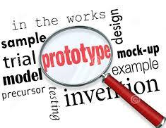
Memory jog…

Slide 10
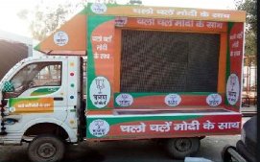
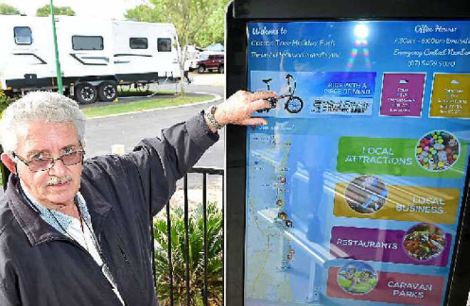
Pop Up Screens
Mobile van in different places
Local info
Digital or physical
Can involve council staff or not
Reaches more and different people

Slide 11
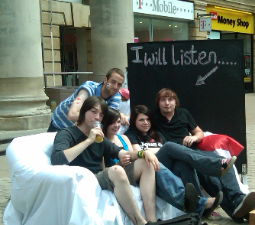
Let’s Talk - Sofa
Mobile, safe space
Unstructured and structured conversations
Reduces isolation
Different physical positioning opens food for thought on how Calderdale has changed

Slide 12
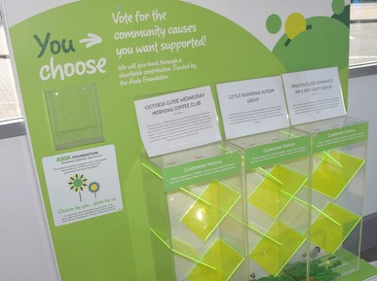
Supermarket slot questions
Local people vote about what matters in Calderdale
Community ideas in public places
Reaches more people in a different way
Tried and tested way for people to have a say

Slide 13
Digital Corner
Rough ideas for mobile apps, from our last workshop – can you help iron them out?
Or are there ways that digital tools could help the other projects be even more effective?

